Slide 1
Spring MVC
EPAM Java training

Slide 2
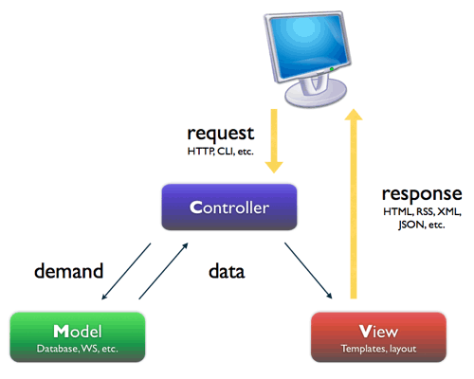
MVC model
Models – Domain objects that are processed by service layer (business logic) or persistent layer (database operation).
Views – Usually JSP or Freemarker page.
Controllers – Interact with service layer for business processing and return a Model.

Slide 3
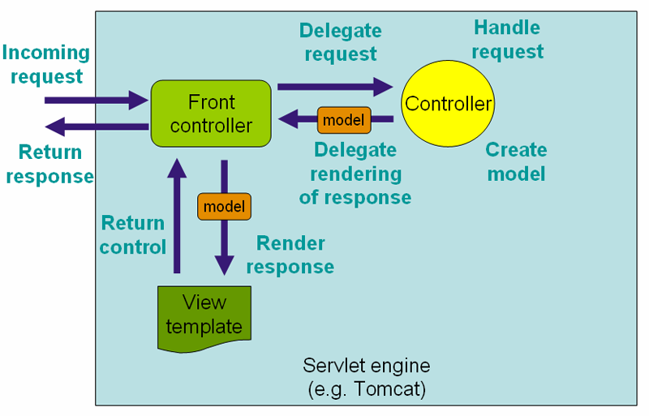
Front Controller pattern
Notes:
The single controller (Dispatcher Servlet) manages all requests to the site.

Slide 4
Spring modules
spring-web module - basic web-oriented integration features such as multipart file upload functionality and the initialization of the IoC container using Servlet listeners and a web-oriented application context.
spring-webmvc module - Spring’s model-view-controller (MVC) and REST Web Services implementation for web applications.

Slide 5
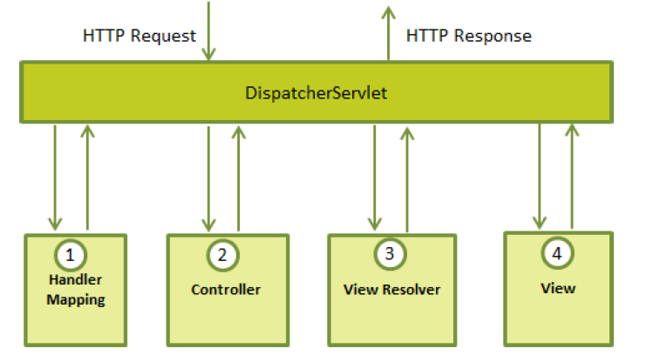
Dispatcher Servlet
After recieving an HTTP request, DispatcherServlet consults the HandlerMapping to call the appropriate Controller.
The Controller takes the request and calls the appropriate service methods based on used GET or POST method. The service method will set model data based on defined business logic and returns view name to the DispatcherServlet.
The DispatcherServlet will take help from ViewResolver to pickup the defined view for the request.
Once view is finalized, The DispatcherServlet passes the model data to the view which is finally rendered on the browser.

Slide 6
Configuration: web.xml
You need to map requests that you want the DispatcherServlet to handle, by using a URL mapping in the web.xml file:
<web-app id="WebApp_ID" version="2.4"
xmlns="http://java.sun.com/xml/ns/j2ee"
xmlns:xsi="http://www.w3.org/2001/XMLSchema-instance"
xsi:schemaLocation="http://java.sun.com/xml/ns/j2ee
http://java.sun.com/xml/ns/j2ee/web-app_2_4.xsd">
<display-name>Spring MVC Application</display-name>
<servlet>
<servlet-name>app</servlet-name>
<servlet-class>org.springframework.web.servlet.DispatcherServlet</servlet-class>
<load-on-startup>1</load-on-startup>
</servlet>
<servlet-mapping>
<servlet-name>app</servlet-name>
<url-pattern>/app/*</url-pattern>
</servlet-mapping>
</web-app>

Slide 7
Configuration: web.xml
If you do not want to go with default filename as [servlet-name]-servlet.xml and default location asWebContent/WEB-INF, you can customize this file name and location by adding the servlet listenerContextLoaderListener in your web.xml:
<web-app...>
<!-------- DispatcherServlet definition goes here----->
....
<context-param>
<param-name>contextConfigLocation</param-name>
<param-value>/WEB-INF/HelloWeb-servlet.xml</param-value>
</context-param>
<listener>
<listener-class>
org.springframework.web.context.ContextLoaderListener
</listener-class>
</listener>
</web-app>

Slide 8
Configuration: spring config
The [servlet-name]-servlet.xml file will be used to create the beans
<beans xmlns="http://www.springframework.org/schema/beans"
xmlns:context="http://www.springframework.org/schema/context"
xmlns:xsi="http://www.w3.org/2001/XMLSchema-instance"
xsi:schemaLocation="
http://www.springframework.org/schema/beans
http://www.springframework.org/schema/beans/spring-beans-3.0.xsd
http://www.springframework.org/schema/context
http://www.springframework.org/schema/context/spring-context-3.0.xsd">
<context:component-scan base-package="com.example" />
<bean class="org.springframework.web.servlet.view.InternalResourceViewResolver">
<property name="prefix" value="/WEB-INF/jsp/" />
<property name="suffix" value=".jsp" />
</bean>
</beans>
The <context:component-scan...> tag will be use to activate Spring MVC annotation scanning capability.
The InternalResourceViewResolver will have rules defined to resolve the view names.

Slide 9
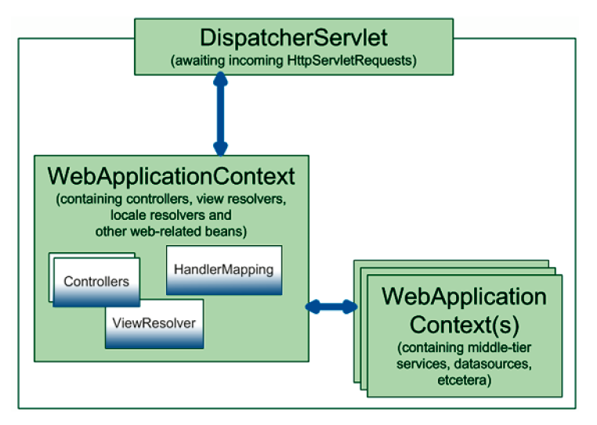
Web Application Context

Slide 10
Web Application Context Utils
Using WebApplicationContextUtils there is possibility to inject Spring beans into HTTP Servlet.
public class ExchangerServlet extends HttpServlet {
private AccountService accountService;
@Override
public void init() throws ServletException {
ServletContext sc = super.getServletContext();
ApplicationContext context = WebApplicationContextUtils
.getWebApplicationContext(sc);
accountService = context.getBean(AccountService.class);
}
}

Slide 11
Defining a Controller
DispatcherServlet delegates the request to the controllers to execute the functionality specific to it.
@Controller annotation indicates that a particular class serves the role of a controller
@RequestMapping annotation is used to map a URL to either an entire class or a particular handler method
@RestController combines @Controller and @ResponseBody (returning data rather than a view)
@Controller
@RequestMapping("/hello")
public class HelloController{
@RequestMapping(method = RequestMethod.GET)
public String printHello(ModelMap model) {
model.addAttribute("message", "Hello Spring MVC Framework!");
return "hello";
}
}

Slide 12
Creating view
View file hello.jsp:
Here ${message} is the attribute which was setup inside the Controller
<html>
<head>
<title>Hello Spring MVC</title>
</head>
<body>
<h2>${message}</h2>
</body>
</html>

Slide 13
Mapping requests
by path
@RequestMapping("/welcome")
by HTTP method
@RequestMapping(value = "/welcome", method=RequestMethod.GET)
by presence / value of query parameter
@RequestMapping(params = {"find=ByMake", "form" })
by presence / value of request header
@RequestMapping(value = "/welcome", headers="accept=text/*")

Slide 14
Use case controller
@RequestParam – param from HTTP request
@PathVariable - map the URI variable to method arguments
@ModelAttribute – model from HTTP request
@Controller
@RequestMapping("/hello")
public class HelloWorldController {
@RequestMapping(value = "/{userId}", method = GET)
public String helloWorld(
@RequestParam("address") final String address
@PathVariable("userId") Long userId,
@ModelAttribute("customer") Customer customer,
Model model) {
model.addAttribute(“user", User.findUser(userId));
return "helloWorld";
}
}

Slide 15
MVC
Model
Controller
public class Car {
private Long id;
private Brand brand;
private String model;
private BigDecimal price;
}
@Controller
public class CarsController {
@RequestMapping("/cars")
public String helloWorld(Model model) {
List<Car> carList = new ArrayList<Car>();
model.addAttribute("carList", carList);
return "cars";
}
}

Slide 16
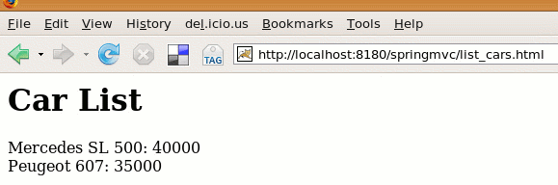
MVC
View
Result
<%@ taglib prefix="c" uri="http://java.sun.com/jsp/jstl/core" %>
<html>
<body>
<h1>Car List</h1>
<c:forEach items="${carList}" var="car">
${car.brand.name} ${car.model}: ${car.price}
<br />
</c:forEach>
</body>
</html>

Slide 17
Return types
ModelAndView
Model / Map / ModelMap
View
String / void
@ResponseBody / @ModelAttribute

Slide 18
SessionAttributes
list the names or types of model attributes which should be stored in the session
@Controller
@SessionAttributes("car")//@SessionAttributes(value={}, types={})
public class CarController {
public String updateForm(@PathVariable("id") Long id, Model model) {
m.addAttribute("car", Car.findCar(id));
}
}

Slide 19
RequestHeader
typical request header
obtain request header
narrow mappings
host = localhost:8080
user-agent = Mozilla/5.0 (Windows; U; Windows NT 5.1; en-US; rv:1.9.2.13) Gecko/20101203 Firefox/3.6.13 ( .NET CLR 3.5.30729; .NET4.0E)
accept = text/html,application/xhtml+xml,application/xml;q=0.9,*/*;q=0.8
accept-language = en-us,en;q=0.5
@RequestMapping("/welcome")
public void welcome(@RequestHeader("user-agent") String agent) {}
@RequestMapping(value = "/welcome", headers="accept=text/*")
public void welcome() {}

Slide 20
CookieValue
get the JSESSIONID of the cookie
@RequestMapping(value = "/welcome")
public void welcome(@CookieValue("JSESSIONID") String session){
}

Slide 21
Data Representation
template view
ViewResolver, View
HTML, Excel, PDF, etc.
data view
HttpMessageConverter
XML, JSON, etc.

Slide 22
View resolver
XmlViewResolver
ResourceBundleViewResolver
UrlBasedViewResolver
InternalResourceViewResolver
BeanNameViewResolver
ContentNegotiatingViewResolver

Slide 23
View
JSP & JSTL
Tiles
Velocity
FreeMarker
etc.
prefix
redirect:
forward:

Slide 24
UrlBasedViewResolver
use case
If @Controller return "cars/show"
view class will process "/WEB-INF/jsp/cars/show.jsp"
<bean id="viewResolver"
class="org.springframework.web.servlet.view.UrlBasedViewResolver">
<property name="viewClass" value="org.springframework.web.servlet.view.JstlView" />
<property name="prefix" value="/WEB-INF/jsp/" />
<property name="suffix" value=".jsp" />
</bean>

Slide 25
Exception Handling
Using try/catch
Using @ExceptionHandler
try{… … …} catch(…){… … …}
@ExceptionHandler(IOException.class)
public String handleIOException(IOException ex, HttpServletRequest request) {
return "error";
}

Slide 26
Validation
Model
Controller
public class Person {
@Size(min=2, max=30)
private String name;
@NotNull
@Min(18)
private Integer age;
}
@RequestMapping(value="/", method=RequestMethod.POST)
public String checkPersonInfo(@Valid Person person, BindingResult bindingResult) {
if (bindingResult.hasErrors()) {
return "form";
}
return "redirect:/results";
}

Slide 27
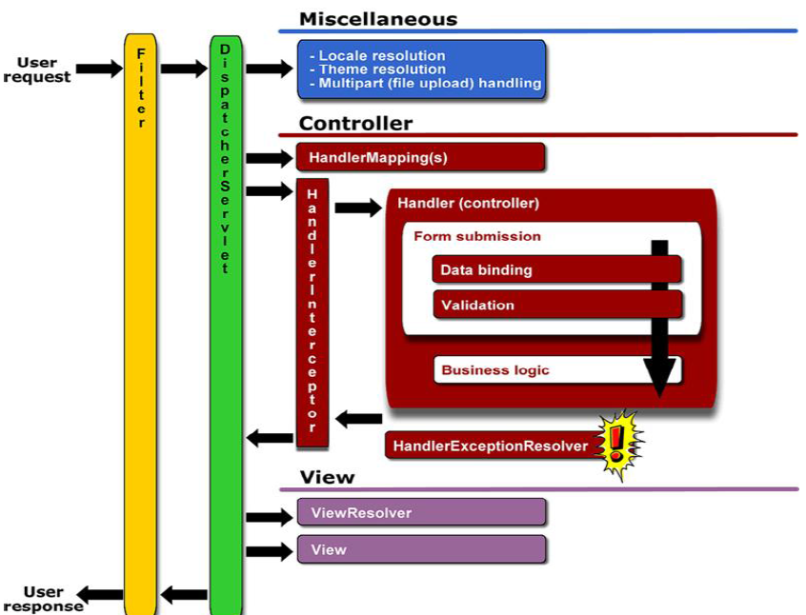
Spring MVC Request Lifecycle

Slide 28
Maven
<dependency>
<groupId>org.springframework</groupId>
<artifactId>spring-web</artifactId>
<version>4.1.0.RELEASE</version>
</dependency>
<dependency>
<groupId>org.springframework</groupId>
<artifactId>spring-webmvc</artifactId>
<version>4.1.0.RELEASE</version>
</dependency>

Slide 29
Resources
reference
http://spring.io
http://docs.spring.io/spring/docs/current/spring-framework-reference/html/mvc.html
http://www.mkyong.com/tutorials/spring-mvc-tutorials/
http://www.tutorialspoint.com/spring/spring_web_mvc_framework.htm
blog
http://spring.io/blog
forum
http://forum.spring.io/forum/spring-projects/web

